Slide 1
CAPSTONE PROJECT
LOAN APPROVAL
BY - RITHESH KUNCHAKURI
CHUBB

Slide 2


AGENDA
Introduction
Source
Data warehouse Data Model
Mappings
Workflow
Parameters, Dependency, PMCMD
Derived Insights
Mappings
Parameters
Workflow
PMCMD
Dependency

Slide 3

"Should the Loan Be Approved?"
An ETL-driven project leveraging the SBAnational dataset, Informatica for data processing, MS SQL Server and Python for insights to predict loan approval outcomes.
With facts and dimension tables, a data warehouse model is being built with the intention of producing a useful data resource.
INTRODUCTION

Slide 4

SOURCE
SBAnational

Slide 5

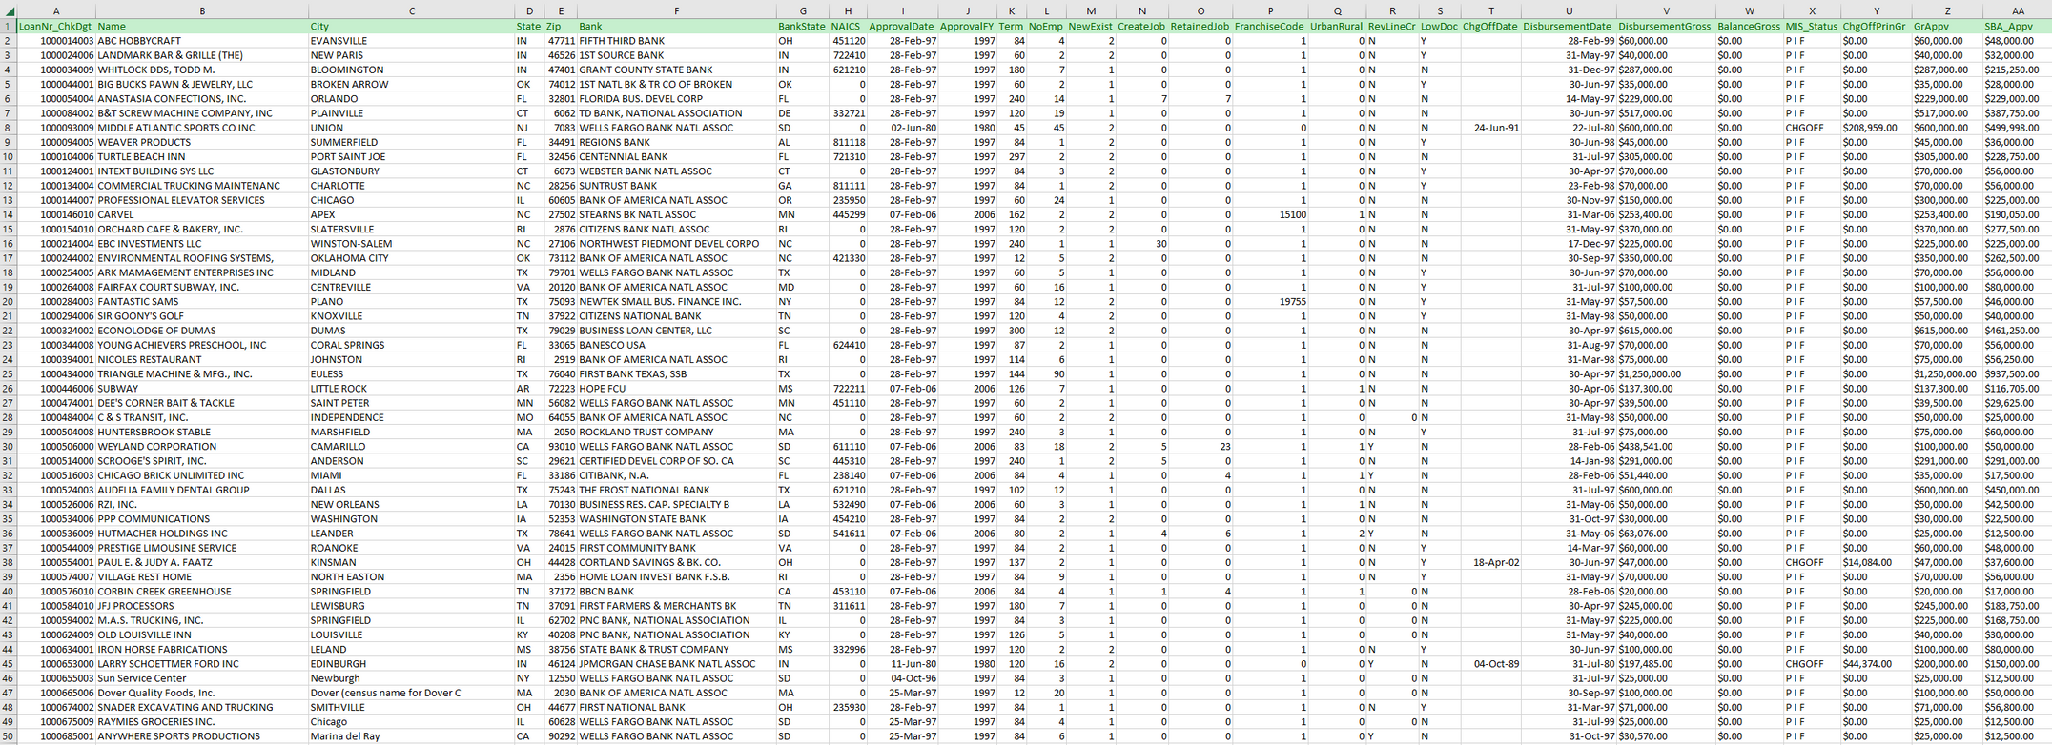
SBAnational
Size - 171 MB
Rows - 8,99,165
Columns - 27

Slide 6

1
STAGING TABLE

Slide 7

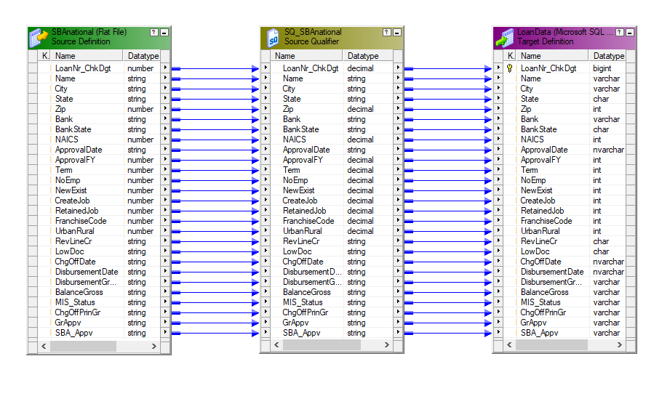
STAGING
LoanData
Data load from flat file SBAnational to database LoanData
A staging table is an intermediate storage area used for data processing in ETL processes, sitting between data sources and targets like data warehouses.

Slide 8
3
DIMENSIONS

Slide 9
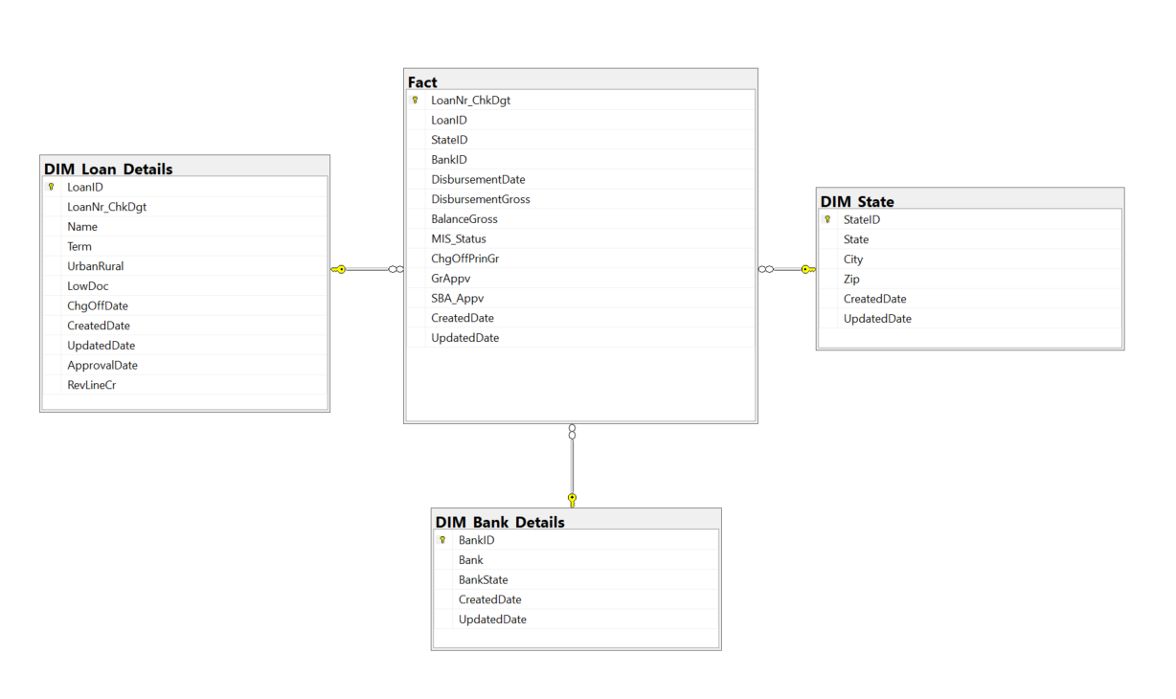
Data Warehouse Data Model

Slide 10
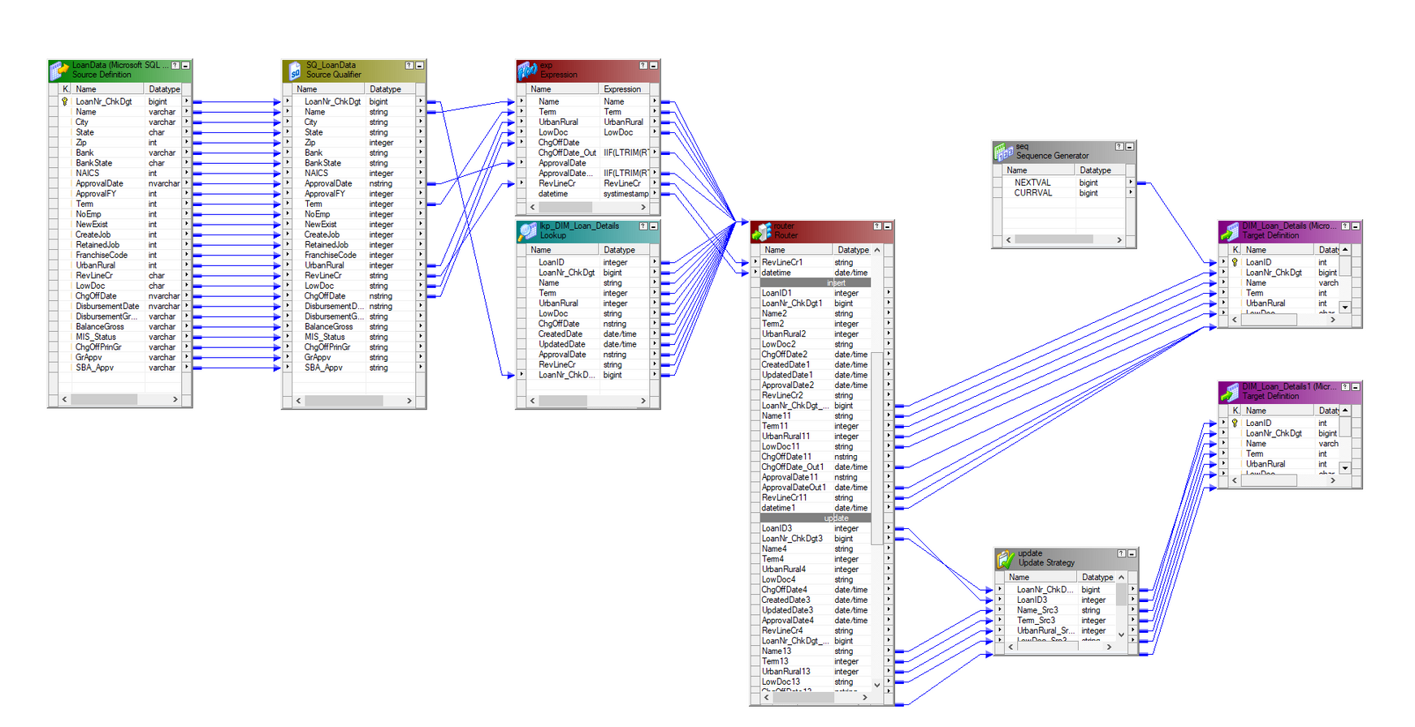
DIMENSION - 1
DIM_Loan_Details
It is a dimension table storing loan-related attributes

Slide 11
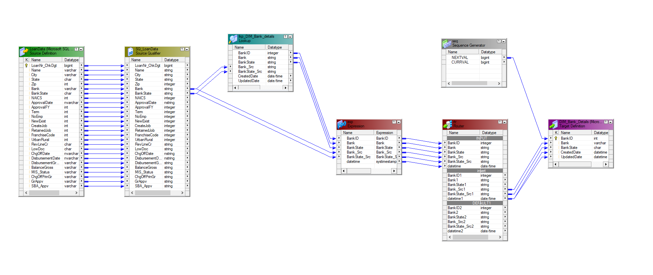
DIMENSION - 2
DIM_Bank_Details
It is a dimension table storing Bank-related attributes

Slide 12
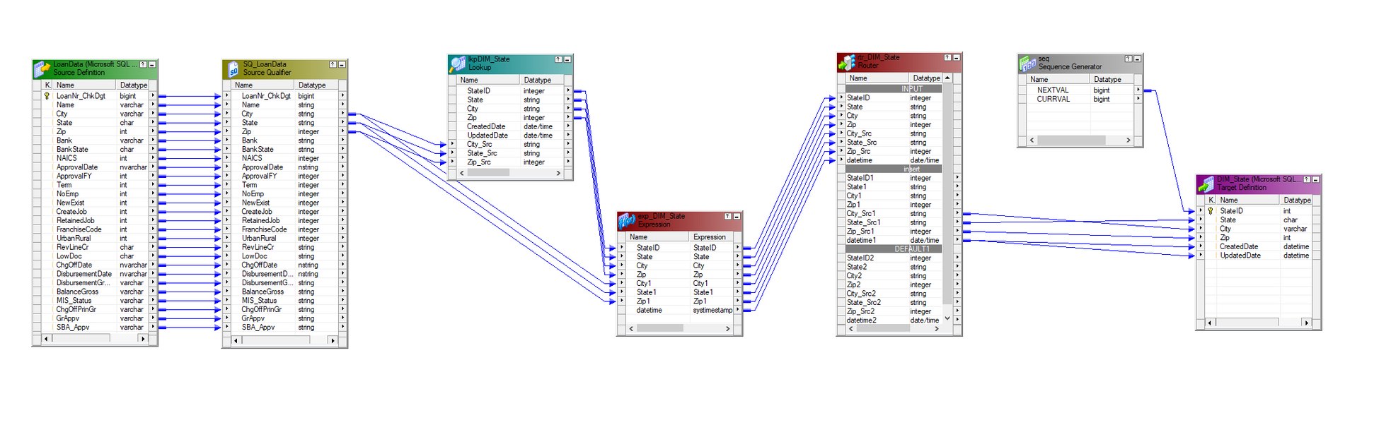
DIMENSION - 3
DIM_State
It is a dimension table storing state and location related attributes

Slide 13
1
FACT TABLE

Slide 14
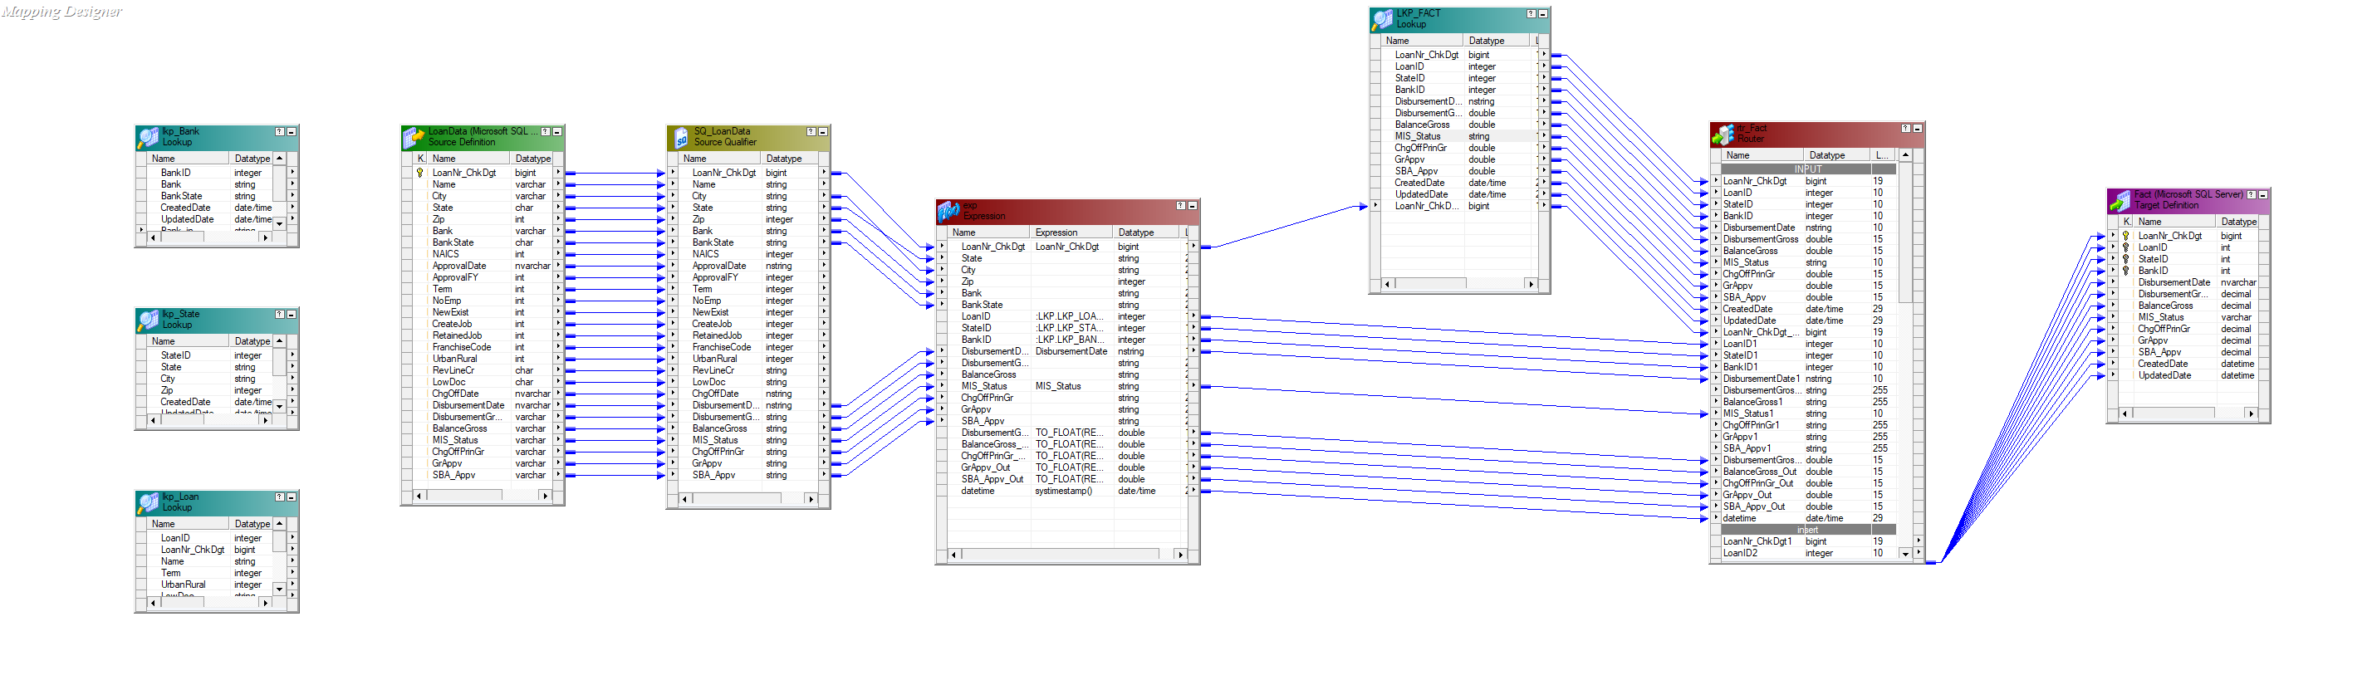
FACT TABLE
FACT
A fact table stores (Majors) quantitative data for analysis in data warehousing, surrounded by dimension tables, facilitating business insights.

Slide 15

ORKFLOW
Informatica Workflow is a sequence of tasks to process, transform, and integrate data between applications, databases, or data warehouses.

Slide 16
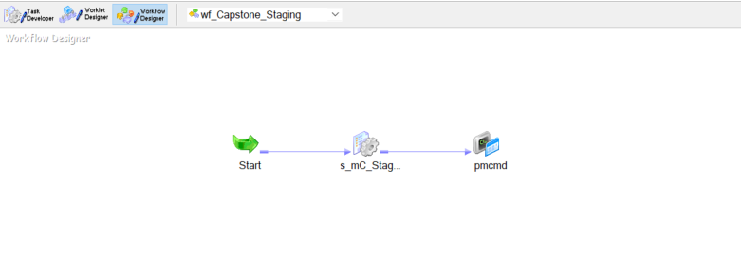
WORKFLOW - 1
wf_Capstone_Staging
The staging workflow in Informatica includes a session (s_mC_Staging) that executes a mapping (mc_Staging), depicting data transfer and transformation processes between source and target systems.

Slide 17
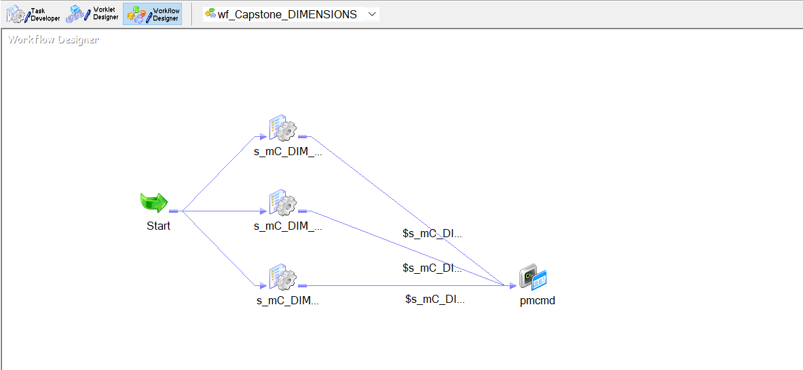
WORKFLOW - 2
wf_Capstone_DIMENSIONS
The dimensions workflow in Informatica includes THREE sessions (s_mC_DIM_Bank_Details, s_mC_DIM_Loan_Details, s_mC_DIM_State)

Slide 18
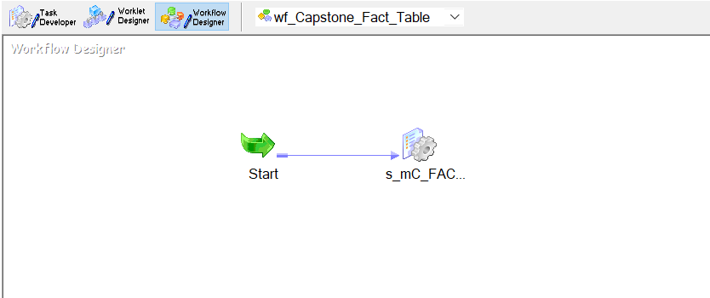
WORKFLOW - 3
wf_Capstone_Fact_Table
The Fact Table workflow is executed once the DIMENSIONS workflow is successfully executed, this allows for proper data population

Slide 19
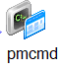
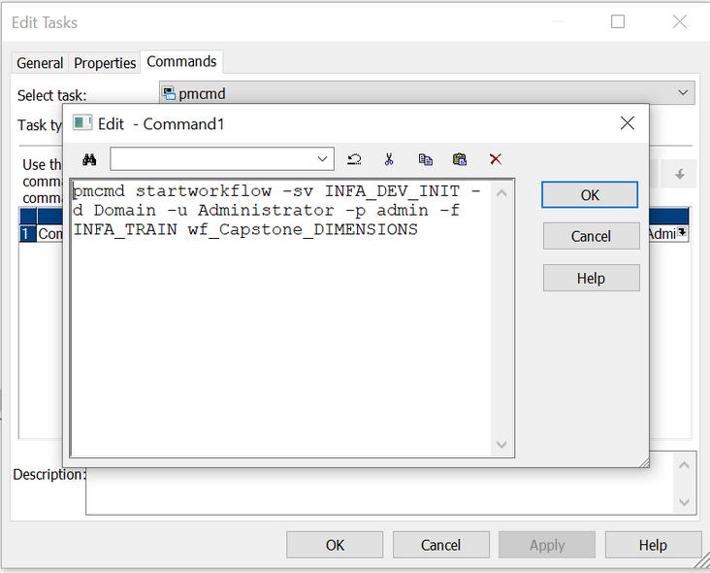
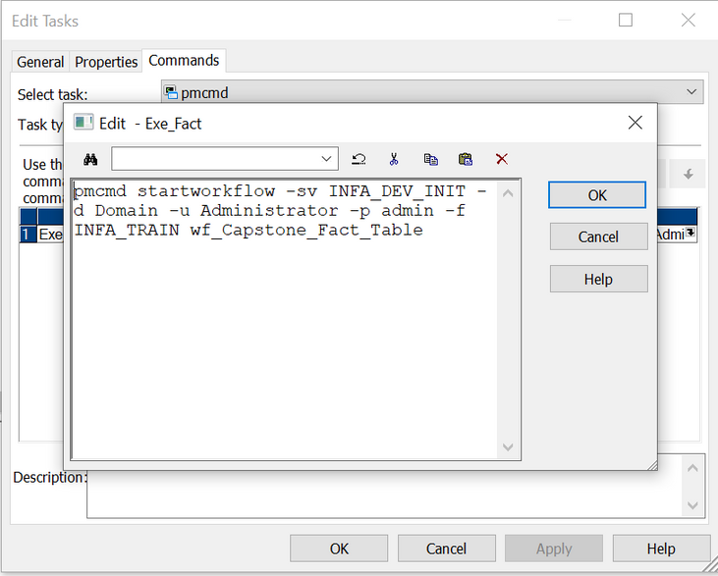
PMCMD
The pmcmd command in Informatica PowerCenter is a command-line utility used for running tasks, workflows, and managing Informatica objects from a command line or script.
To execute wf_Capstone_DIMENSIONS
To execute wf_Capstone_Fact_Table

Slide 20
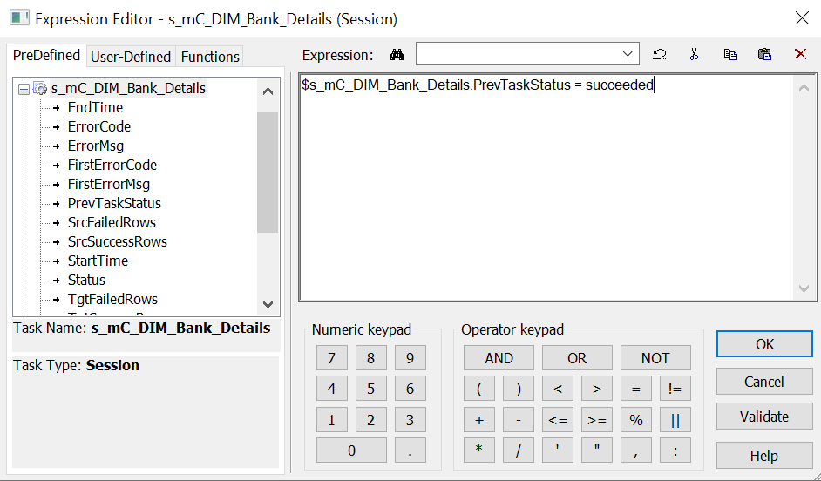
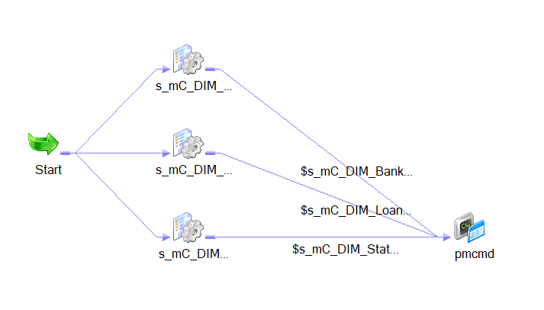


DEPENDENCY
In Informatica PowerCenter, dependency refers to the relationships between objects, ensuring proper execution order and integrity in workflows and mappings.

Slide 21
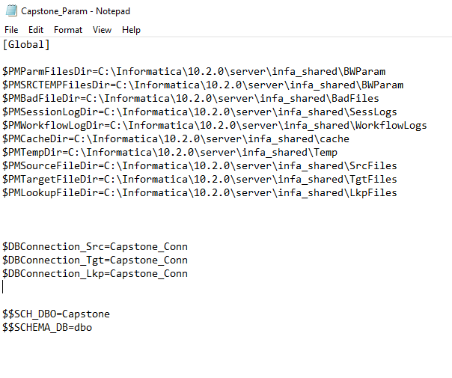
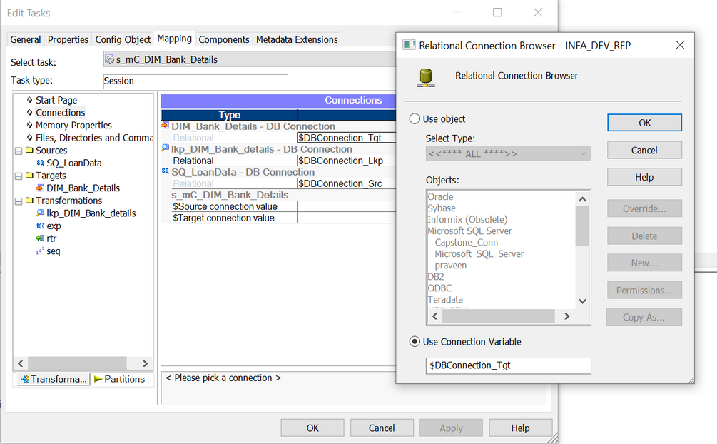
PARAMETERS
Parameterization in Informatica PowerCenter allows dynamic value assignment to mappings and workflows, enabling flexible data processing and transformation.
Path - C:\Informatica\10.2.0\server\infa_shared\BWParam\Capstone_Param.prm

Slide 22
10
INSIGHTS

Slide 23
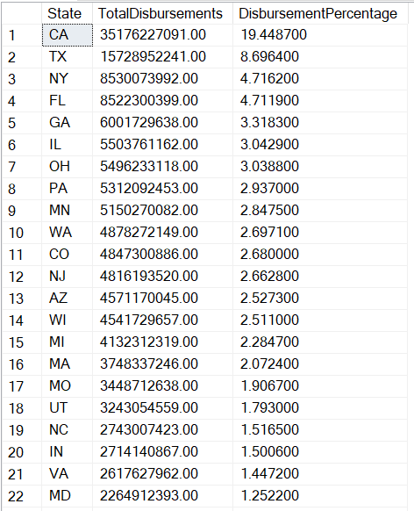
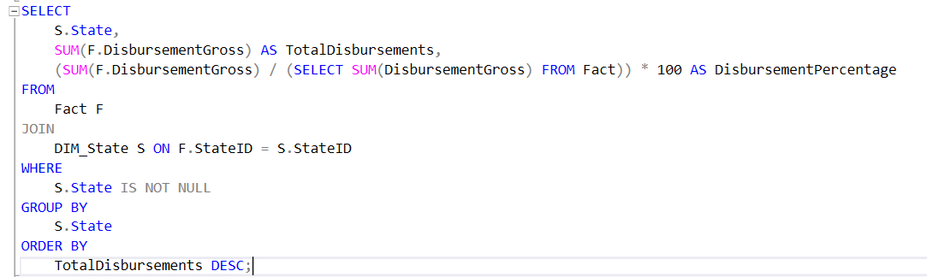
DERIVED INSIGHT - 1
1. Total Disbursements by State
The total disbursements by state, which can give insight into the distribution of loan disbursements across different states.

Slide 24
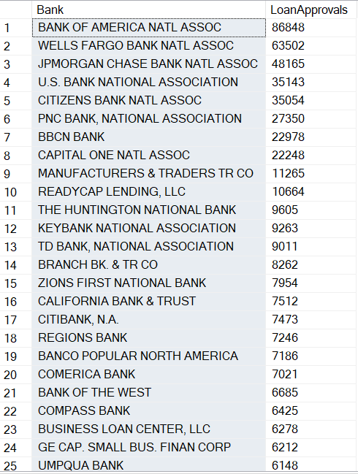
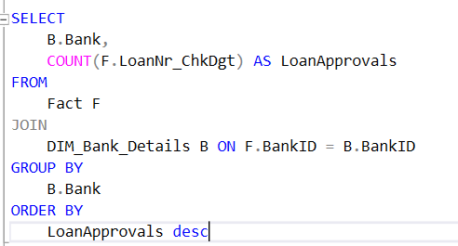
DERIVED INSIGHT - 2
2. Loan Approvals by Bank
This query provides insight into the volume of loan approvals by each bank,
which can be useful for understanding the distribution of loan approvals across different financial institutions.

Slide 25
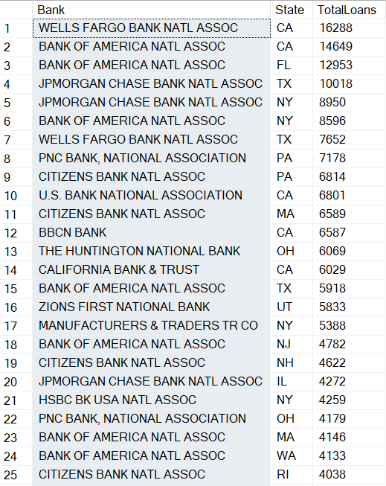
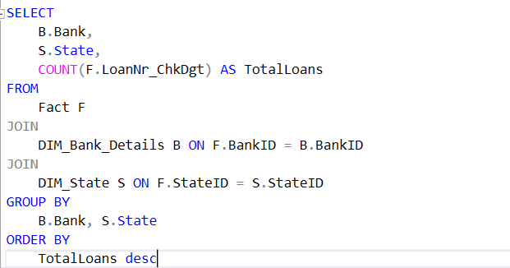
DERIVED INSIGHT - 3
3. Total Loans by Bank and State
This query combines information from the Fact table with the DIM_Bank_Details and DIM_State tables to show the total number of loans issued by each bank in each state.

Slide 26
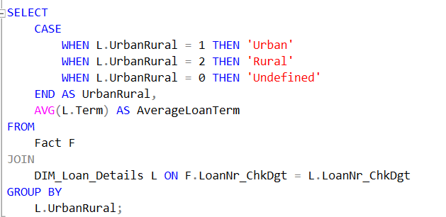
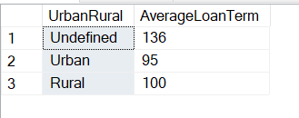
DERIVED INSIGHT - 4
4. Average Loan Term by Urban/Rural
the average loan term for loans categorized as urban and rural, providing insights into the loan terms based on the location of the borrower.

Slide 27
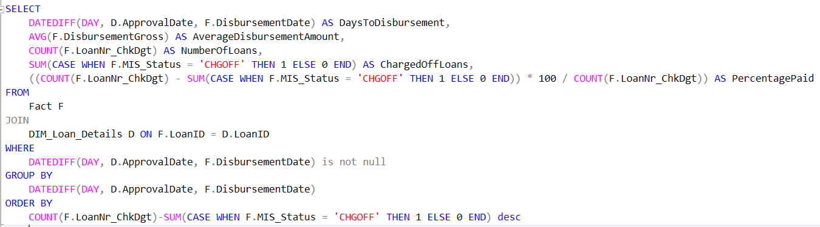
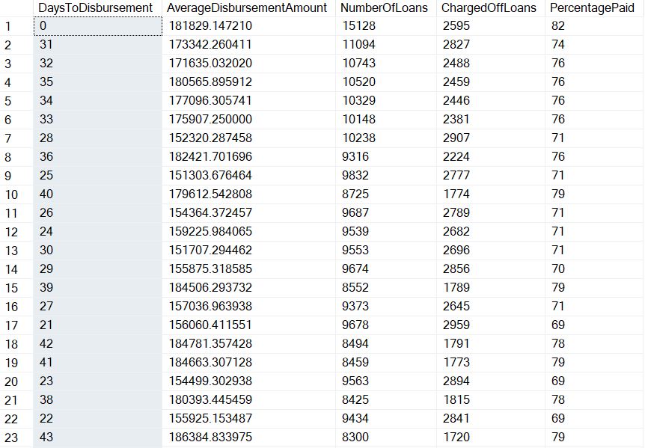
DERIVED INSIGHT - 5
5. Number of days it took from the approval of the loan to the actual disbursement of the funds.
Assuming that the funds were received could have a negative relationship with a business's ability
to repay a loan, whereas the longer it took to receive funds, the more difficult it would be to pay off the loan.
ordered it by difference between the number of loans and the charged off loans that means the days from top to bottom represent the ideal days it took for the business to recieve money to successfully repay the debt and have minimum charged off loans
charged off loan is that a lender has written off a loan as a loss.

Slide 28
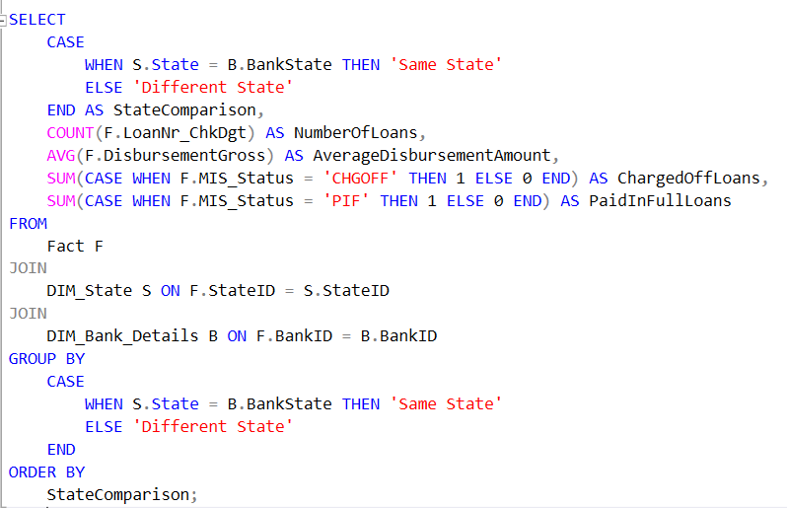
DERIVED INSIGHT - 6
6. whether or not the bank servicing the loan was in the same state that the business was located.
My assumption is that it would be more difficult to service a loan for a business in another state
and that this could have a negative impact on a business's ability

Slide 29
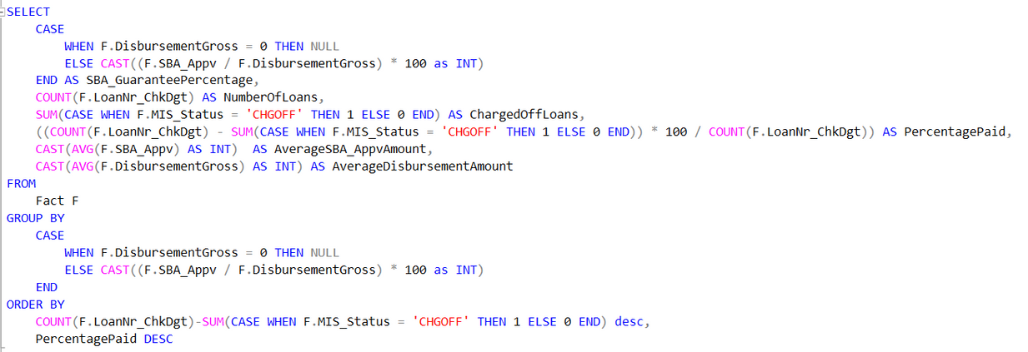
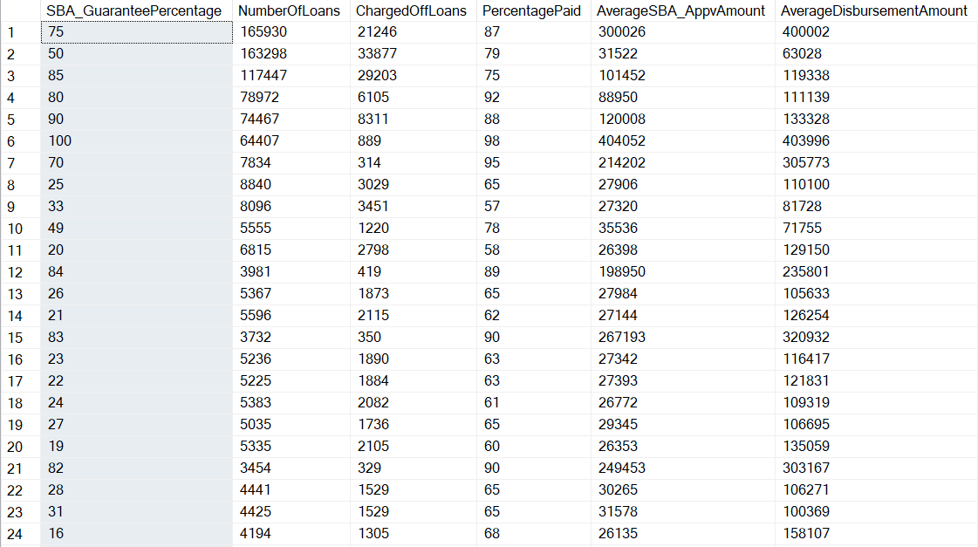
DERIVED INSIGHT - 7
7. amount of the loan the SBA guaranteed
The SBA will 'guaranty' a percentage of the loan in the event of a loss. For example if a business took out a 500,000 loan
and the SBA guaranteed 50%, if the business was unable to repay 200,000 of the loan the SBA would cover 100,000 of that loss.

Slide 30
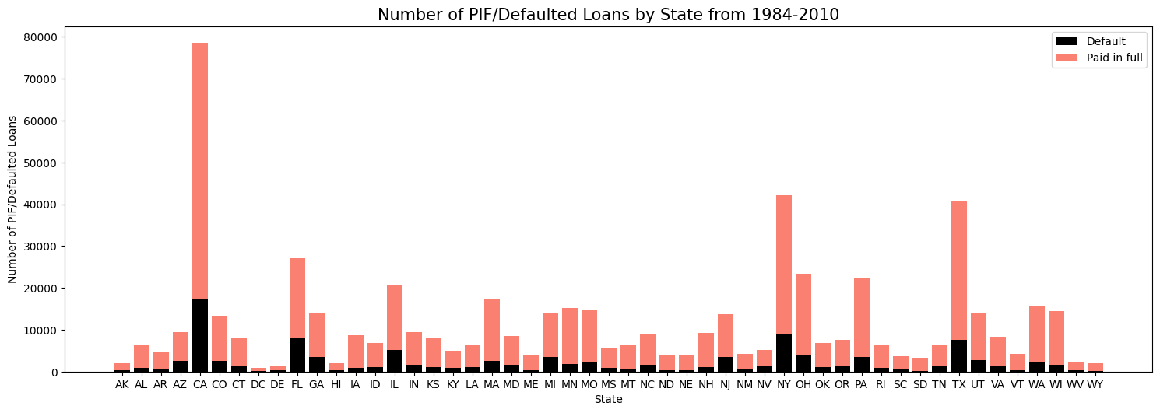
DERIVED INSIGHT - 8

Slide 31
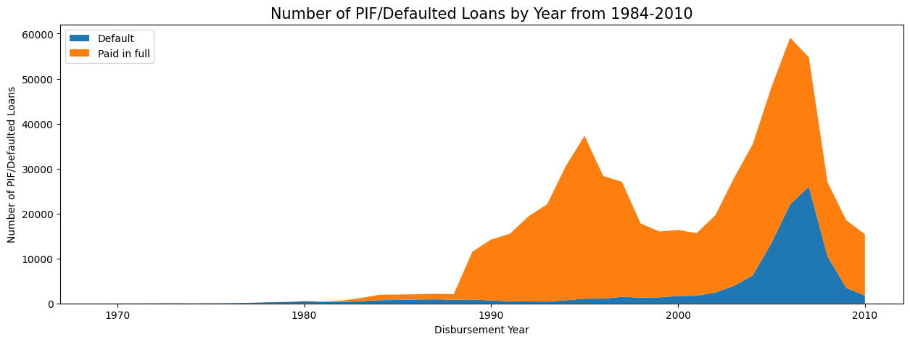
DERIVED INSIGHT - 9

Slide 32
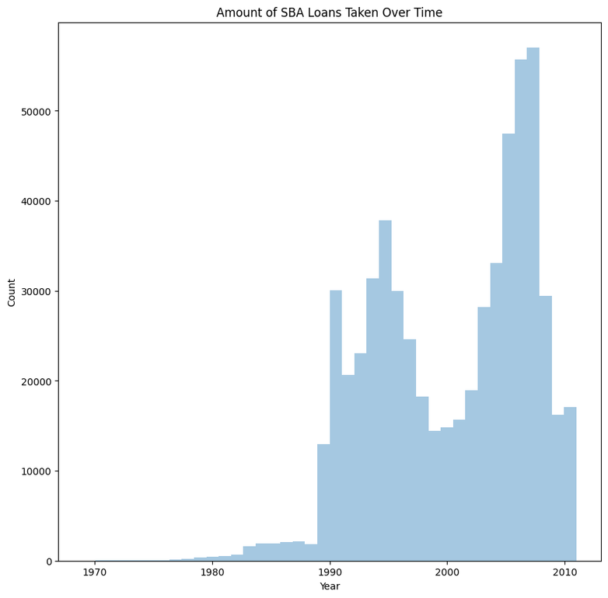
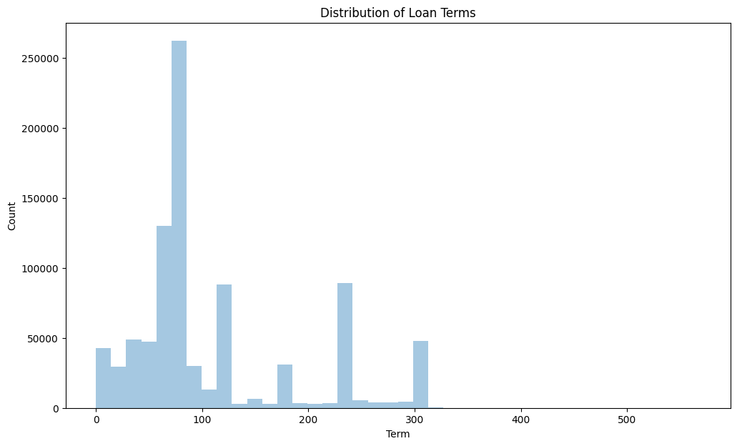
DERIVED INSIGHT - 10

Slide 33
Thank
You!
CHUBB

